Slide 1
Covid-19 spatial Analysis
Jiaying Liang

Slide 2
Content
Datasets Info
Research Questions
Data Processing
Analysis
Things to Improve
Reference
Notes:
There are 5 things I wanna talk abou in today presentaion

Slide 3
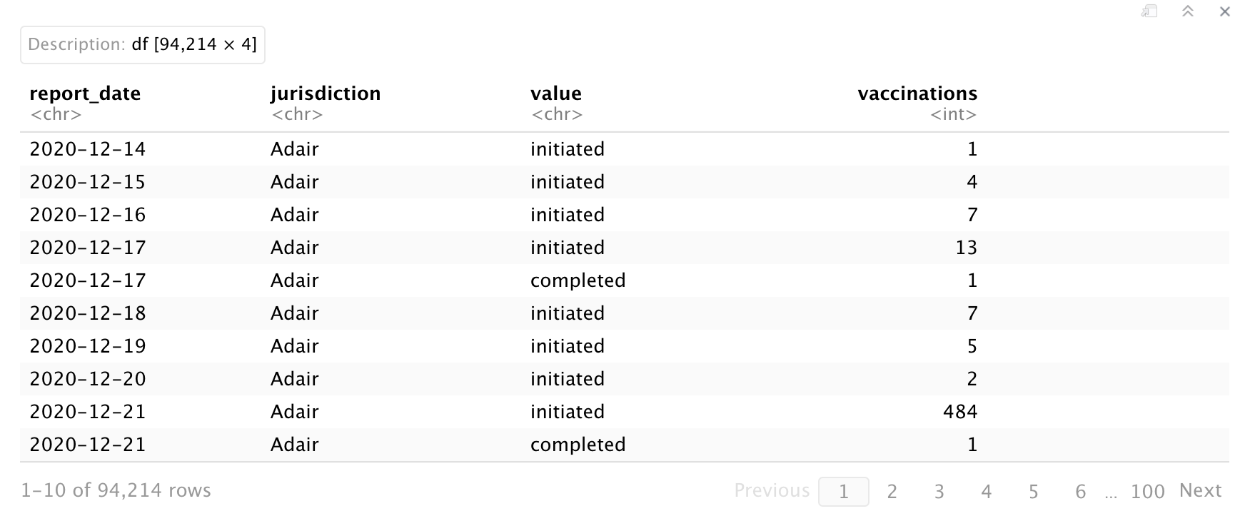
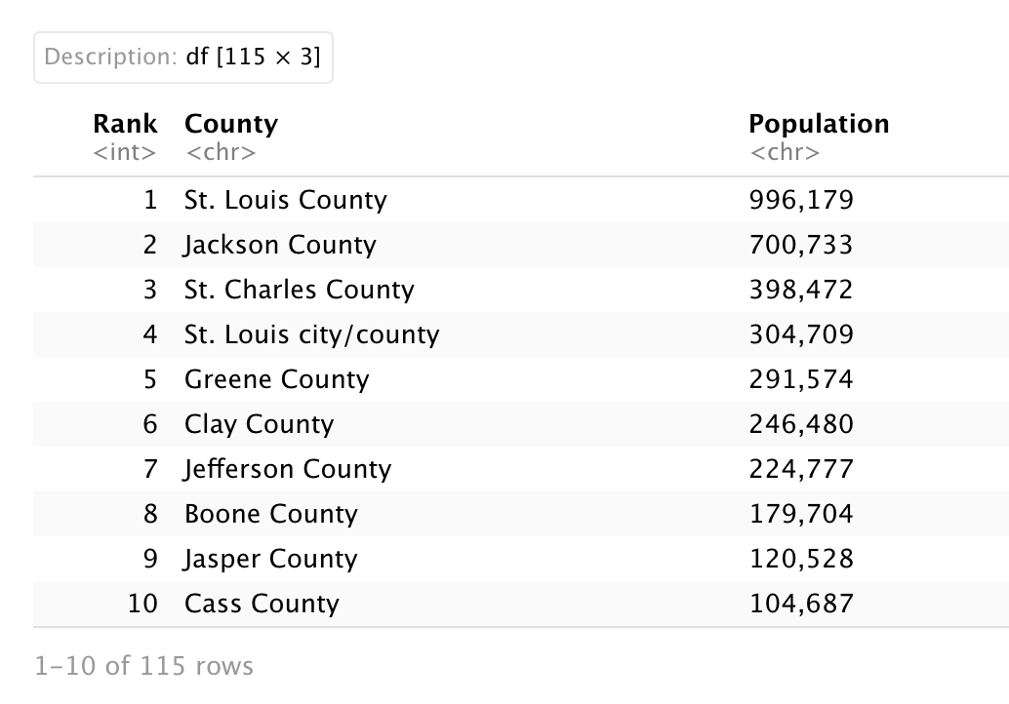
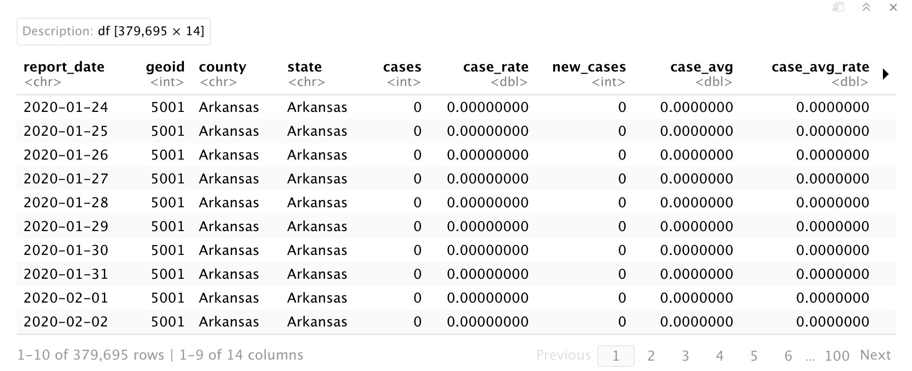
Datasets info
county_full_vaccine
county_full
county_pop
MO = tigris::counties(29)
Notes:
There are four data sources that I used:
County_full_vaccine:
report_date: chr
Jurisdiction: name of counties
Value: initiated, completed
later, I will use this data to compute Moran’s I for the vaccination rate
County_full:
report_date: chr
state: choose MO
Later, I will use this data to compute Moran’s I for the confirmed cases and death rate
County_full, county_full_vaccine are two data from my data science capstone project.
County_pop: is for getting the population for each county in MO:
County: str_sub to delete the County that followed the county names
population: chr, use gsub to delete the comma, as.numeric to change it to double
I git it from Missouri geographic.com.
MO = tigris::counties(29) is one of the data that we used in class for getting the geometry variable.
For the detail data processing, I will talk about them later.

Slide 4
Research Questions
Whether the vaccination rate has spatial autocorrelation?
Whether the confirmed cases has spatial autocorrelation?
Whether the death rate has spatial autocorrelation?
What is the effect of variables, like confirmed cases and vaccination rate on the death rate when we consider the spatial correlation?
Notes:
Before doing any analysis, I came up those four research questions.
After I did some analysis, I change my last questions for getting the BYM model to work. I will talk about it in Analysis part.

Slide 5
Data processing
Moran’s I for vaccination rate
Notes:
The most time consuming part, also is what I think the most important part for my project, is the data processing.
For compute Moran’s I for vaccination rate, I did

Slide 6
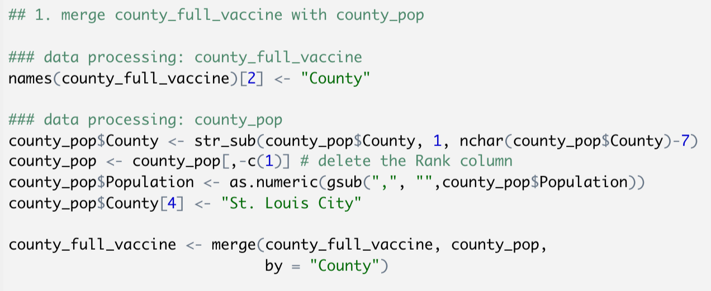
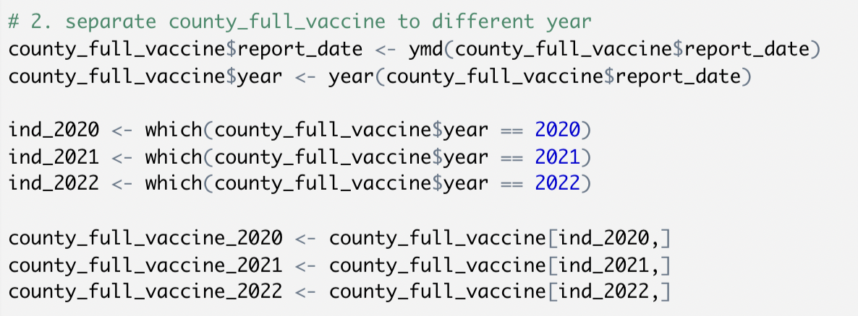
Data processing
Notes:
1.
In order to merge county_full_vaccine and county_pop,
I need to change the name for their county variable to the same variable name. [ “jurisdiction” ]
County variable in county_pop, every county name follows a county, like st. louis county, Jefferson county, so str_sub helps me get rid off last 7 charaters.
Also there is a rank variable which I will not use it, so I delete it.
The class of the population variable is a character, so gsub can delete the comma, as.numeric convert character variable to numeric variable.
St. louis city the C is lower case, in order to merge successfully, I rename it to St. Louis City with capital c.
2.
I want to show whether the vaccination rate has spatial autocorrelation for each year, so I separate the data to different years.
ymd is a function in lubridate that can automatically change the charater variable to date variable, which is helpful for separate the data.

Slide 7
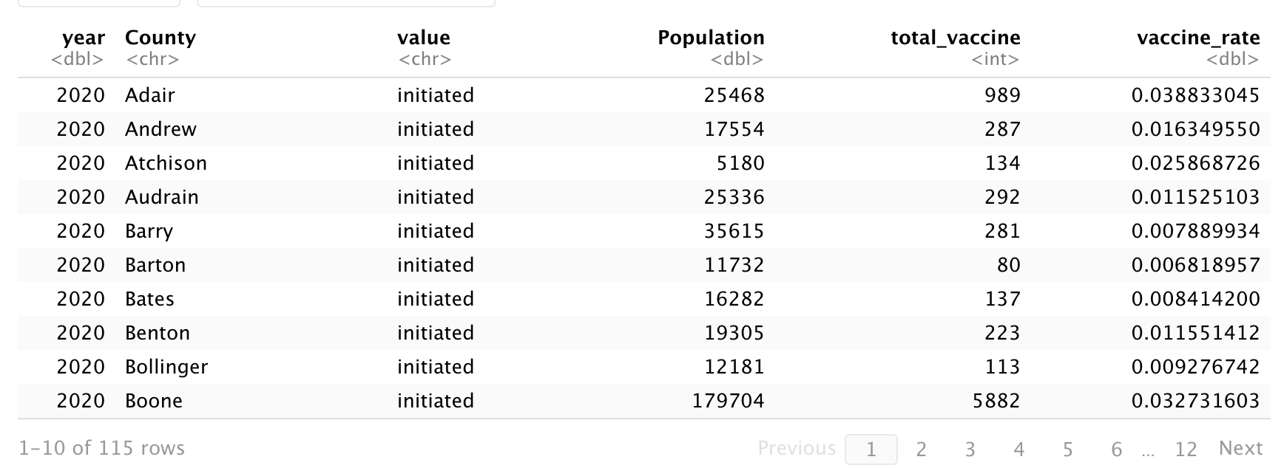
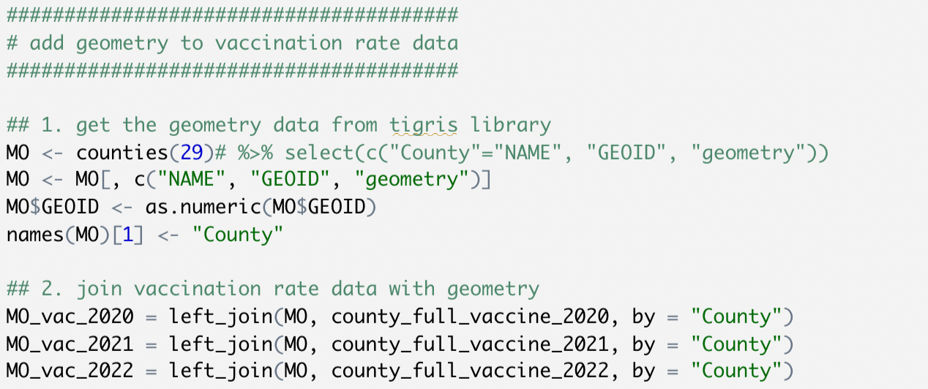
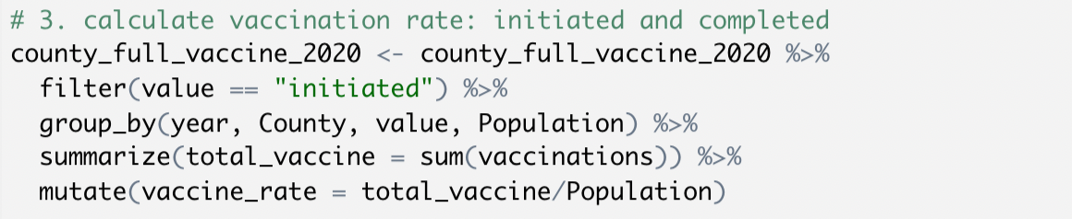
Data processing
Notes:
3.
There are two values for vaccination:
Initiated means get the first dose of vaccine
Completed means get the second does of vaccine.
First, I group data by year, county, value, and population, then I realize the completed data is included in initiated data, so only use initiated data for each county, each year.
Then I did some data processing for Missouri geometry data, then merge it with vaccine data.

Slide 8
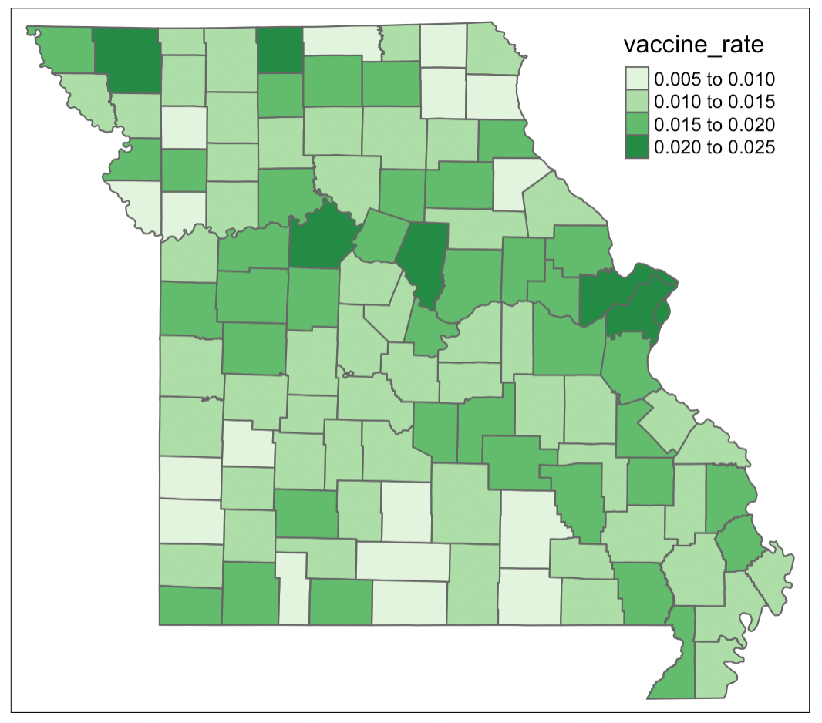
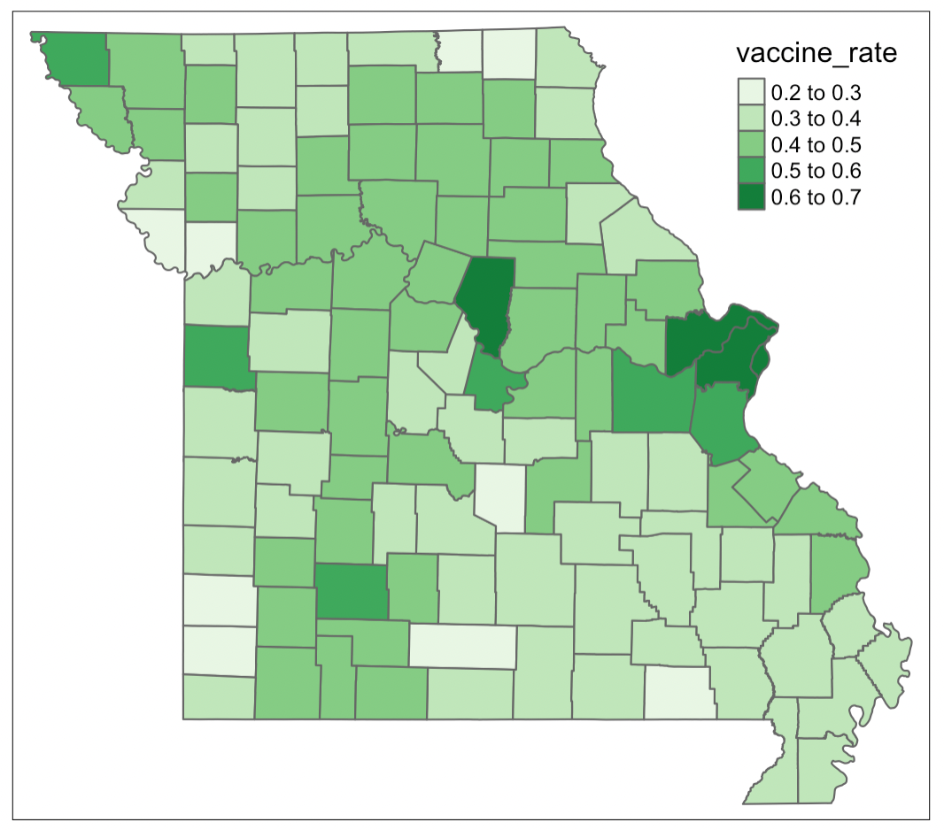
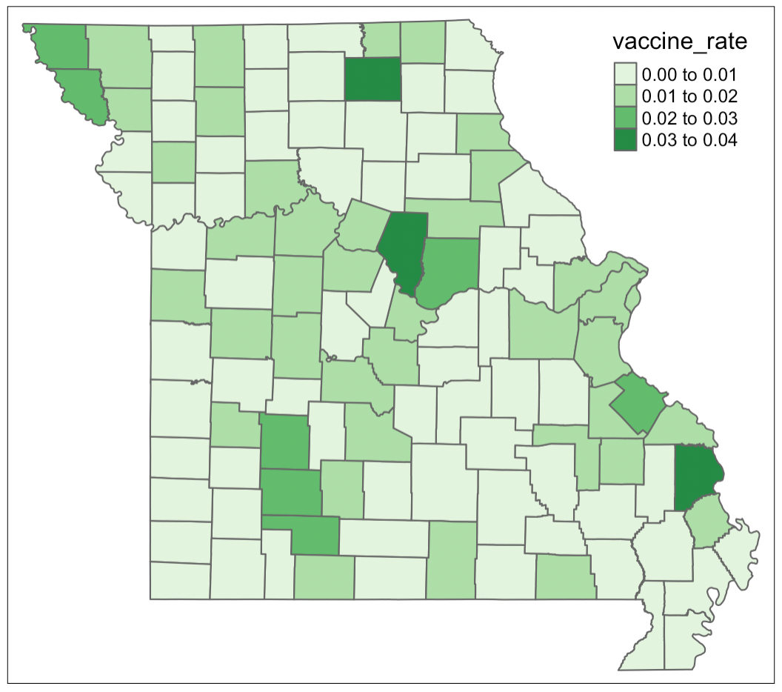
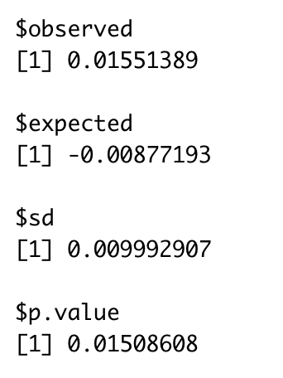
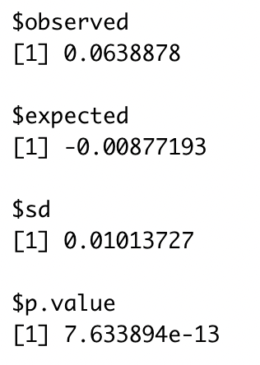
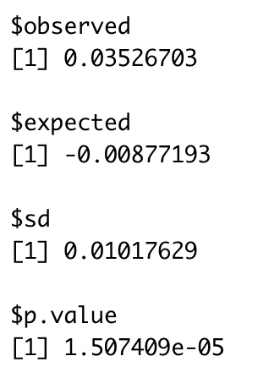
Data processing
Moran’s I for vaccination rate
Change variable name to “County”
Merge county_full_vaccine and county_pop by “County”
Merge Missouri geometry
Convert sf to sp
Get distance matrix, weight matrix, and inverse distance weight matrix
Compute Moran’s I for each year’s vaccination rate
Notes:
Since now we have data in simple feature, we want to convert it to spatial data. Then compute dis_mat, weight_mat, inverse_dis_mat as we did in one of out homework. Then compute Moran’s I for inverse distance matrix for each year’s vaccination rate.
Those three p.value are for 2020, 2021, and 2022
They all pretty small, so that means we reject the null hypothesis, which is the vaccination rate has no spatial autocorrelation.
In conclusion, vaccination rate has spatial autocorrelation for each year.

Slide 9
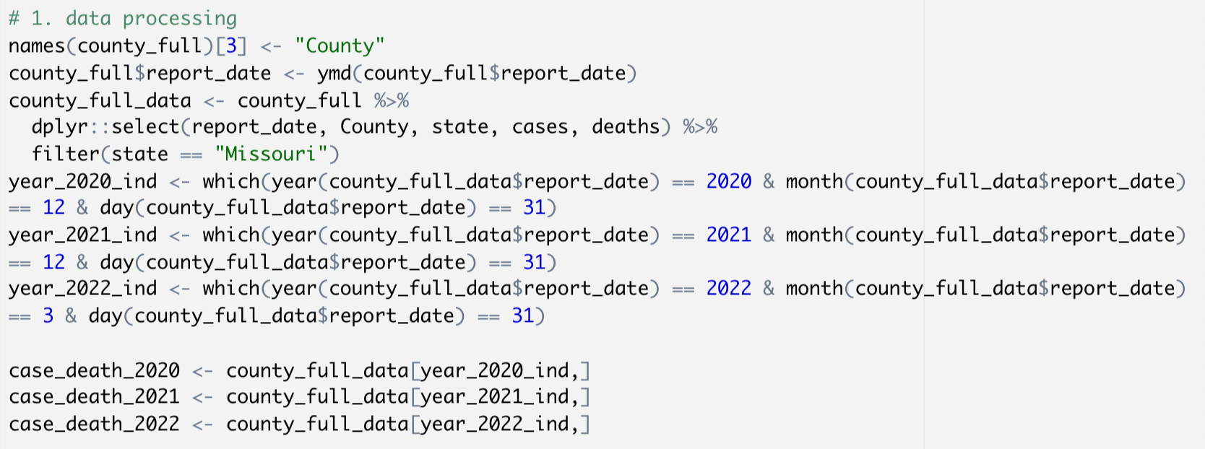
Data processing
Moran’s I for confirmed cases and death rate
Notes:
For compute Moran’s I for confirmed cases and death rate, I did
1.
As I did in last one, change the column name for counties to help to merge with other data.
2.
I found there are data for other state, so I filtered for just Missouri data.
Since there is a select function in raster library, so for using select here, I have to specify dplyr to make it work.
3.
Also I want to analyze it for different years, so I use year, month, day in lubridate library to choose the data for each year.

Slide 10
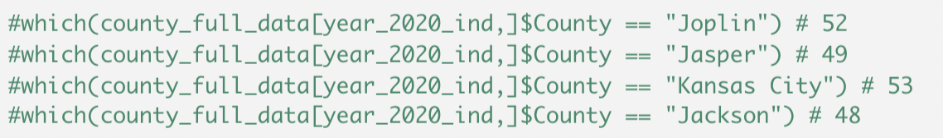

Data processing
Notes:
Then, I found out there are 117 counties in this data file. So I take a close look, found out it make Joplin and Kansas City as counties. Then I googled which counties are they belong to. So the Joplin mainly belong to Jasper county, Kansas city mainly belong to Jackson county.
Then I add those two cities data to their county, then resign it to those county, and delete the data for Joplin and Kansas city.
Since the cases and deaths are cumulated data, so I get the data from 2020, Dec, 31, 2021, dec, 31, and the last day of the data is 2022, March , 31. Then I subtract the data from year before, and resign it to it.
Merge the data with county_pop and create a new column called death_rate by using deaths divide by population.

Slide 11
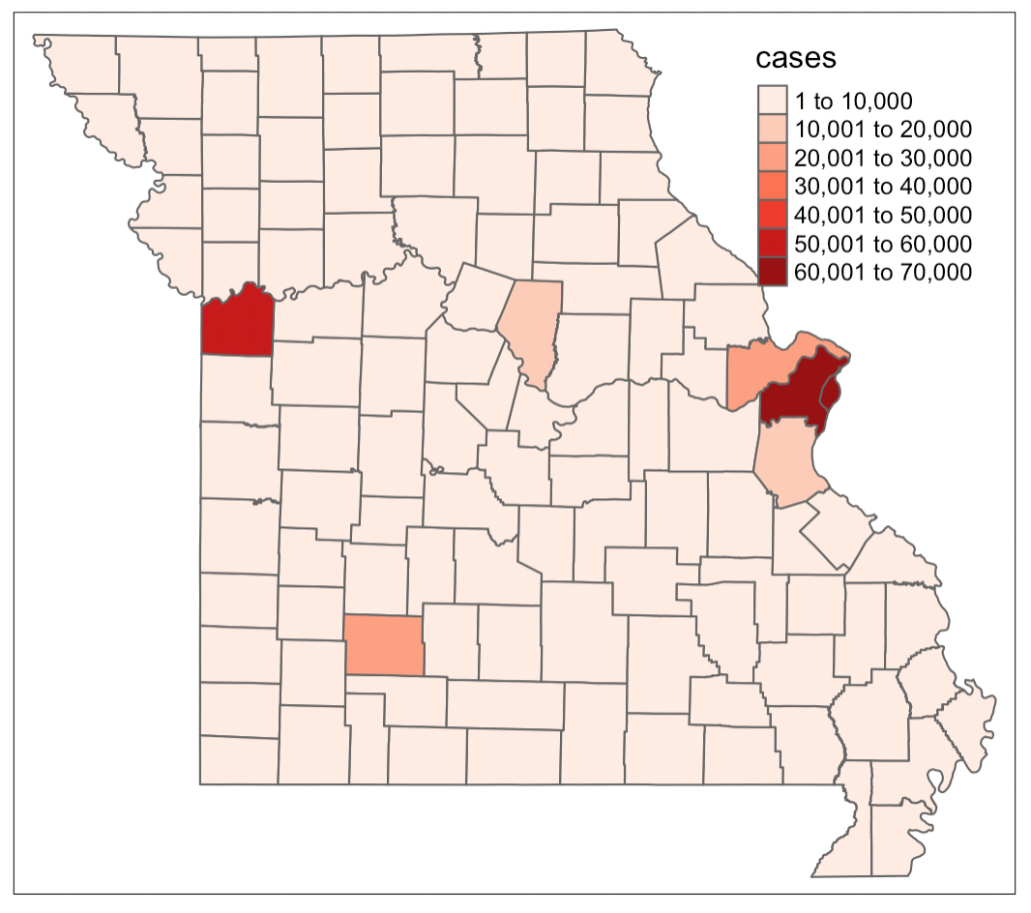
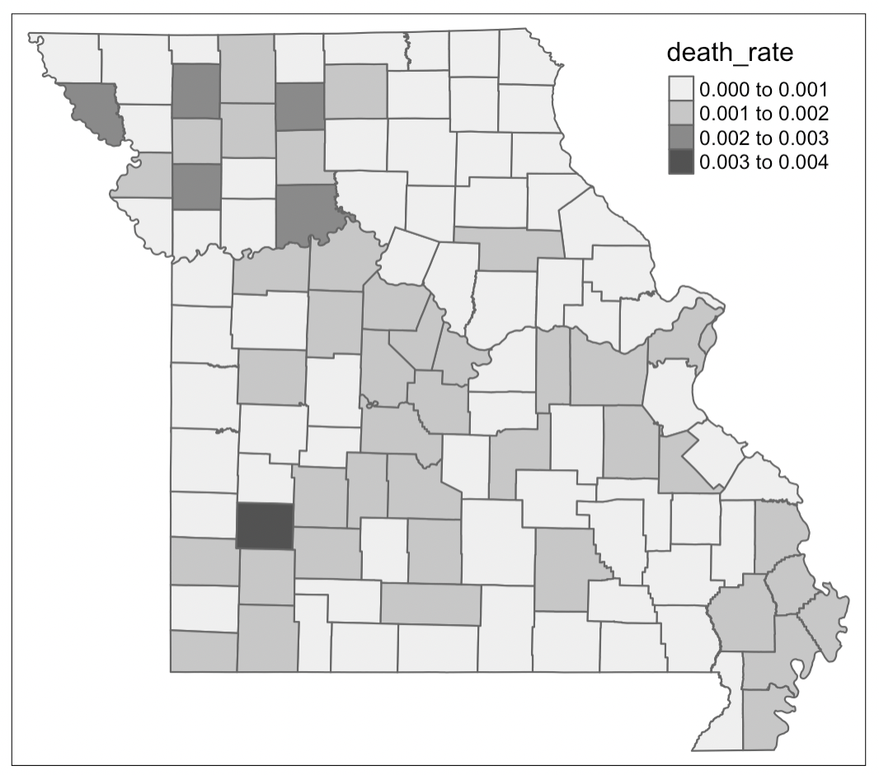
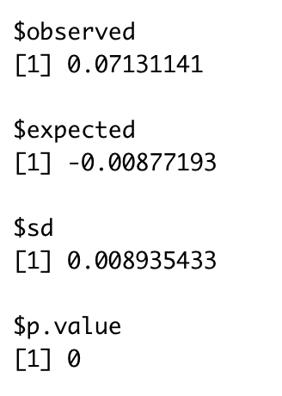
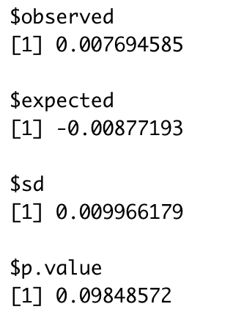
Data processing
Moran’s I for confirmed cases and death rate
Change to the same variable name “County” for merge
Choose Missouri data
Separate data to 2020, 2021, 2022
Deal with two extra cities: Joplin, Kansas City
Get the death rate
Add geometry
Convert sf to sp
Compute distance matrix, weight matrix, and inverse distance weight matrix
Compute Moran’s I
Notes:
Then do the same steps as the last one. After compute Moran’s I:
Those are p-values for 2020, the left is for confirmed cases, right is for death rate.
So, for confirmed cases, it has spatial autocorrelation.
For death rate, the p-value greater than 0.05, we cannot reject null hypothesis, so death rate has no spatial autocorrelation.

Slide 12
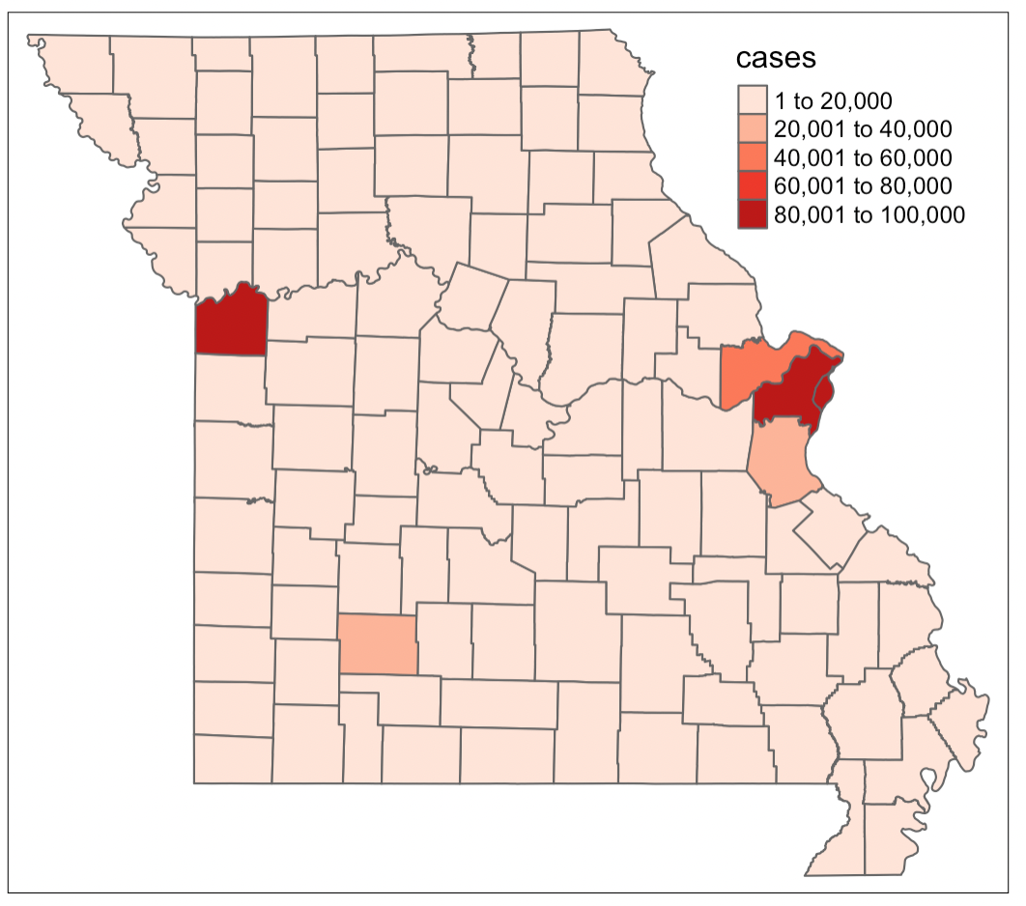
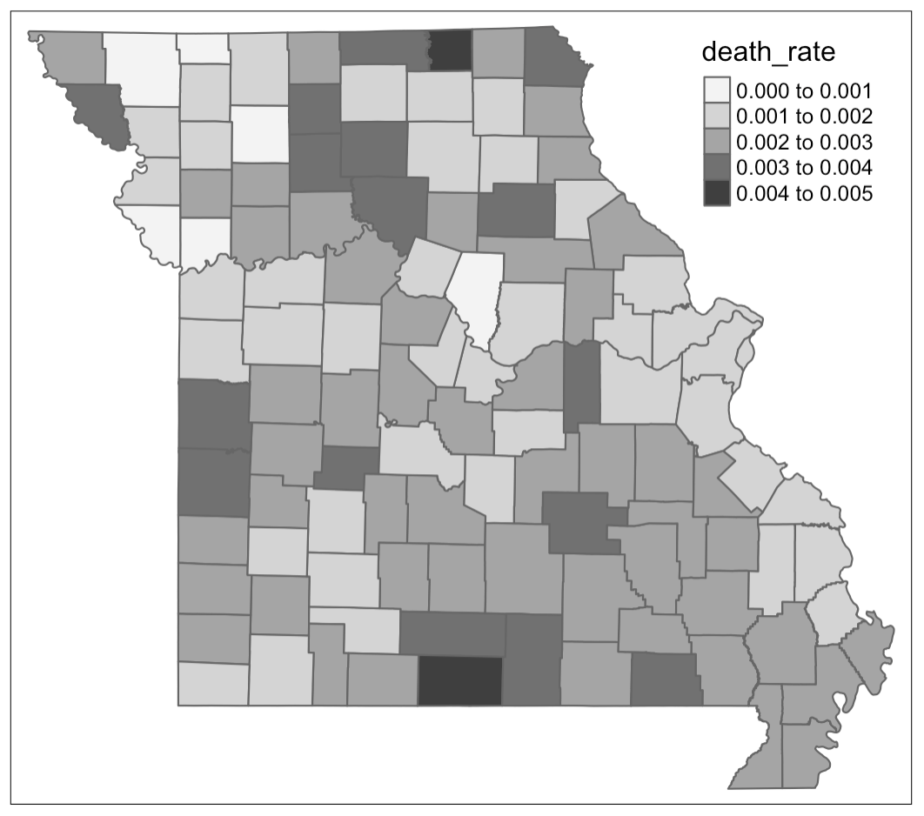
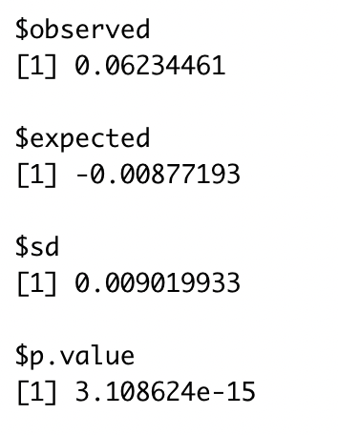
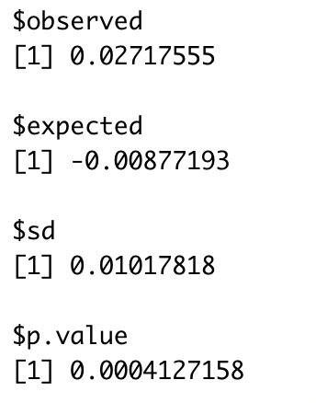
Data processing
Notes:
Both p-values are significant, so we reject null hypothesis.
So, for 2021, the confirmed cases and death rate have spatial autocorrelation.

Slide 13

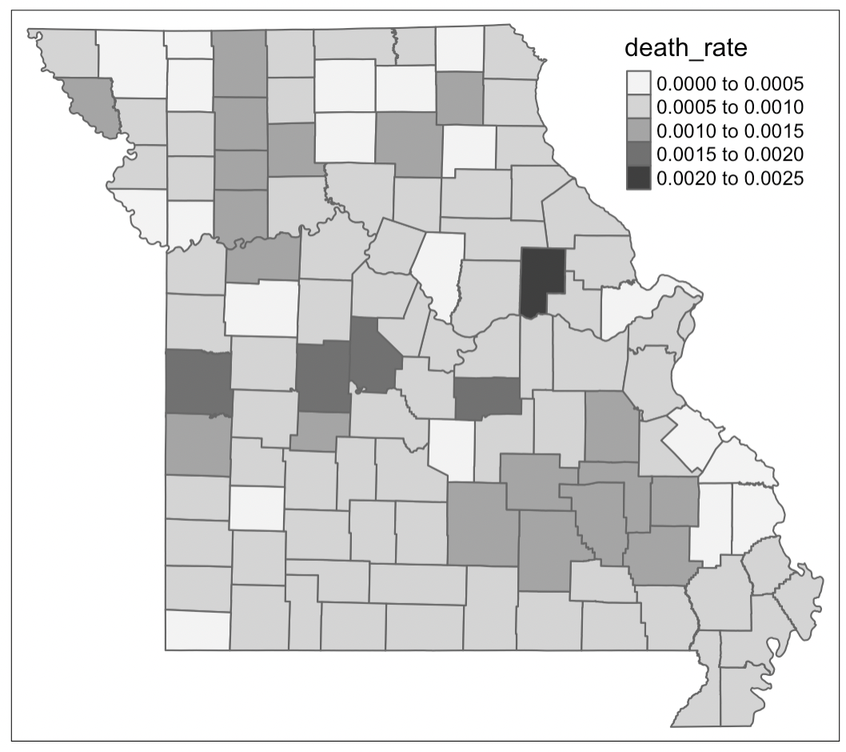
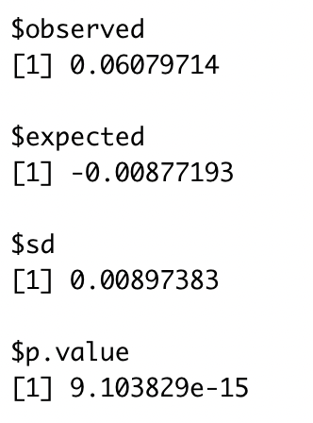
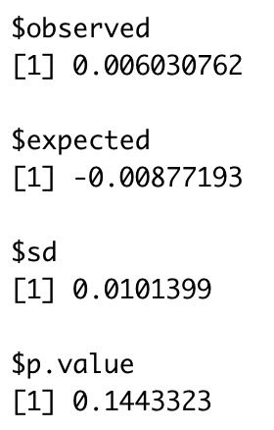
Data processing
Notes:
For 2022, confirmed cases has spatial autocorrelation.
Death rate do not have spatial autocorrelation.

Slide 14
analysis
raster::union to combine SpatialPolygonDataFrame that we create before for each year
Add idarea to each SPDF
Notes:
By apply the bym model,
First, I union the vaccination data with confirmed cases and death rate data for each year. Union is a function in raster library to combine two Spatial Polygon Data Frames. It automatically combine data by the same county name, geoID, and population.
Then add idarea to each SPDF as we did in homework.

Slide 15
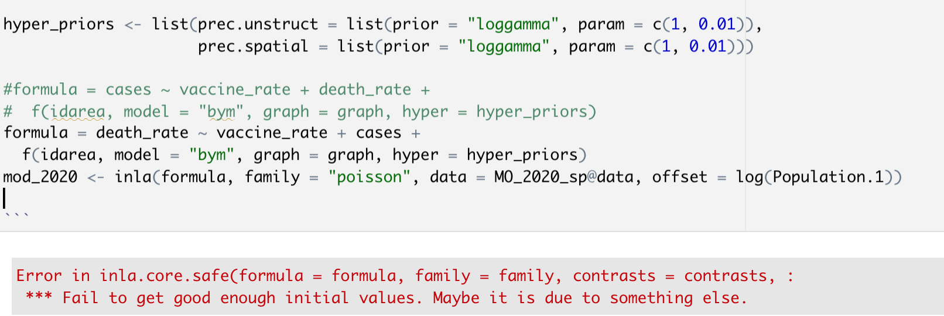
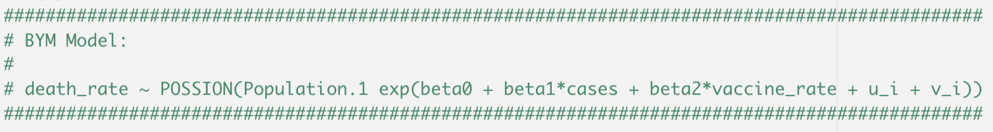
analysis
BYM Model for research question:
What is the effect of variables, like confirmed cases and vaccination rate on the death rate when we consider the spatial correlation?
Notes:
When I run this model, it gave me this error, fail to get good enough initial values, I think the reason is that the death rate is too small to be predicted by vaccine_rate and cases, when the population is the county population.

Slide 16
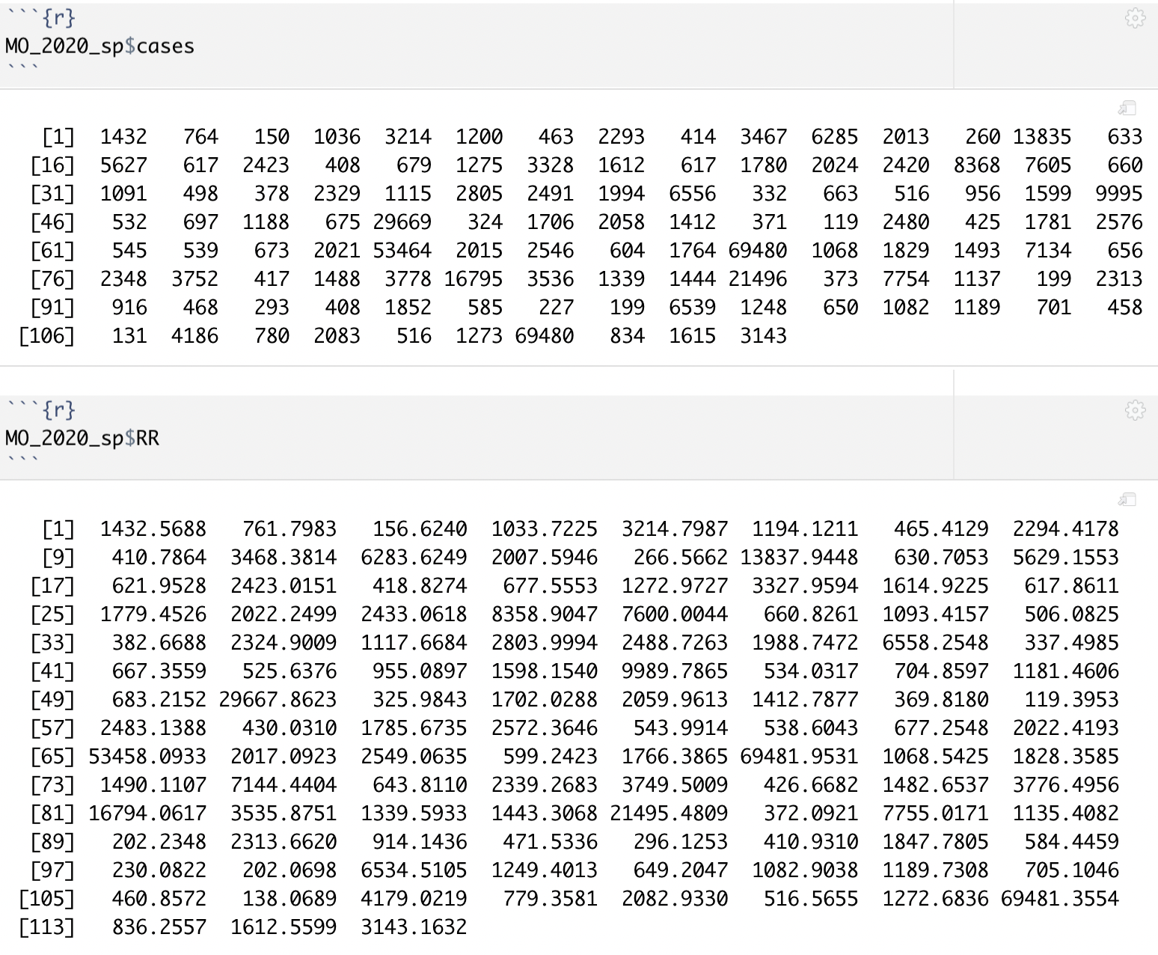
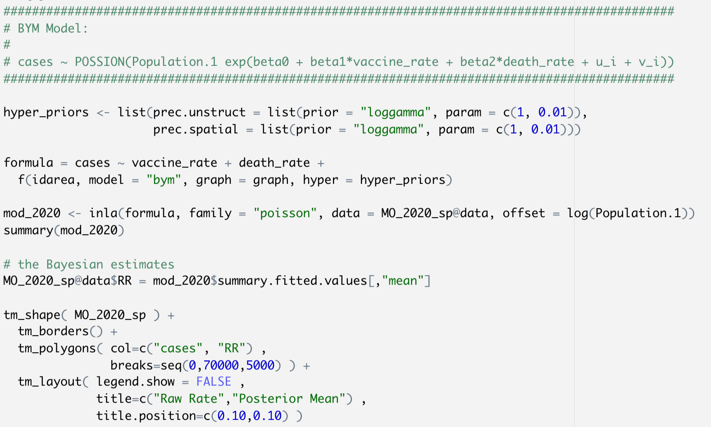
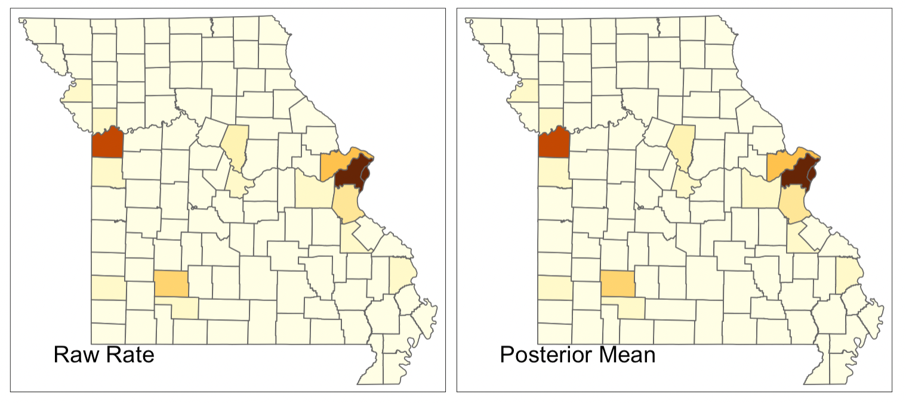
analysis
Notes:
Then I decided to change the model to predict confirmed cases by predictors: vaccine_rate and death rate, when population is county population.
The plot it shows me are exactly same for raw rate and posterior mean. If we take look at the data, we saw there is no much difference between the raw data and posterior mean.
So I conclude that, vaccine rate and death rate effect confirmed cases.

Slide 17
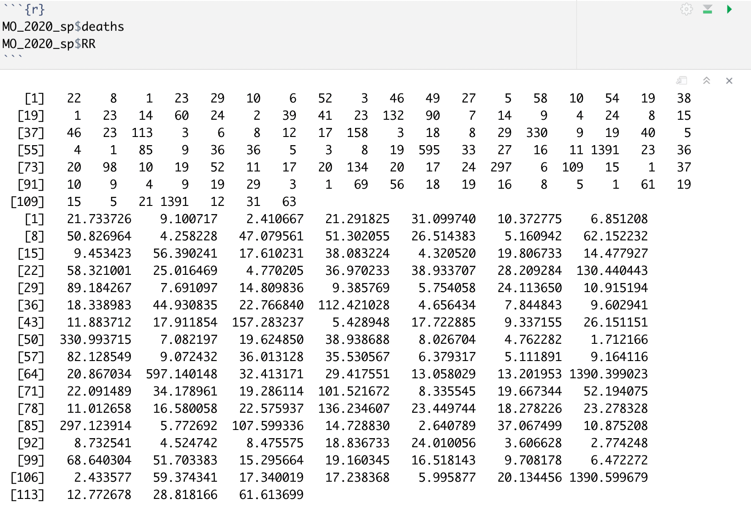
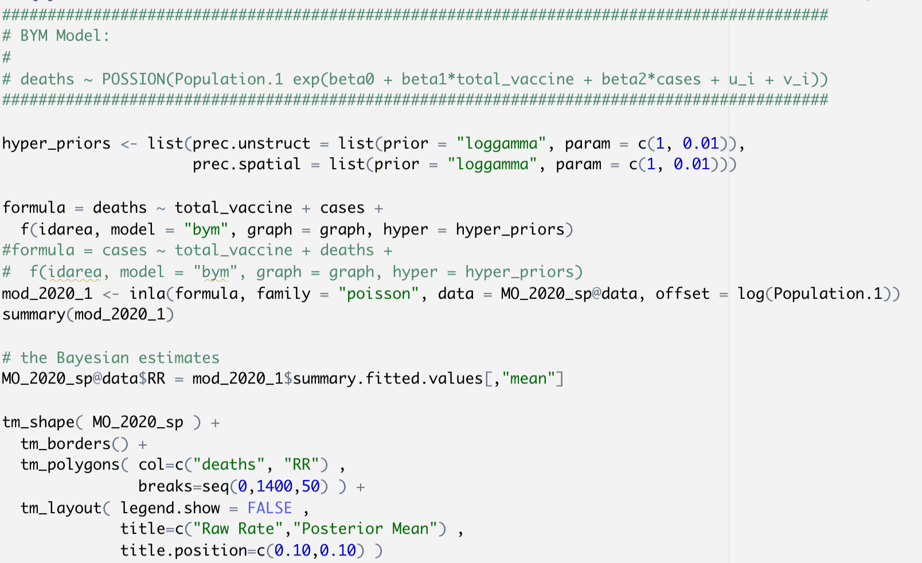
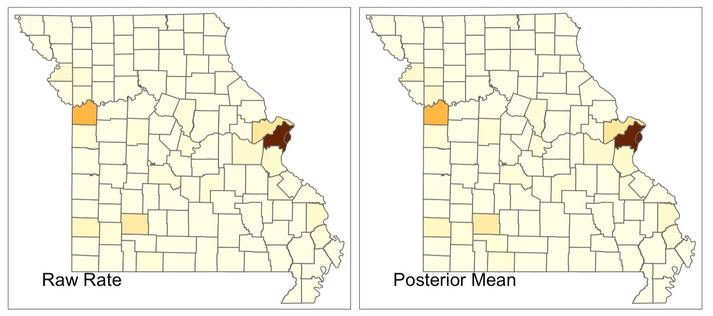
analysis
Notes:
To make more sense on the model, I use total_vaccine and cases to predict deaths.
This is the plot for raw rate and posterior mean. It might be hard to see on the projector, but in the computer screen, you can see they are difference between two.
As the data shows, this model did good job to predict the deaths for 2020 by using total vaccine and cases.

Slide 18
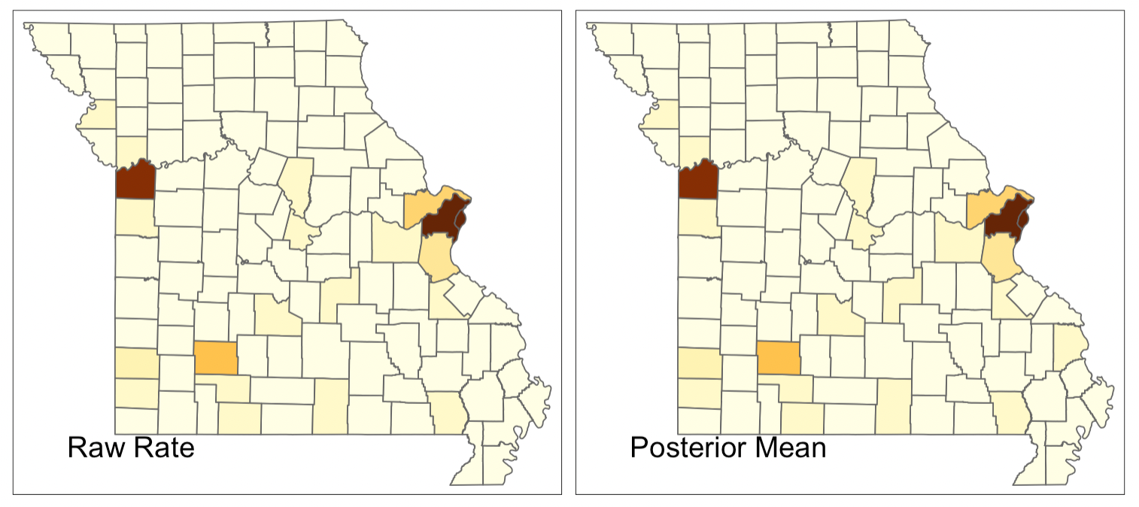
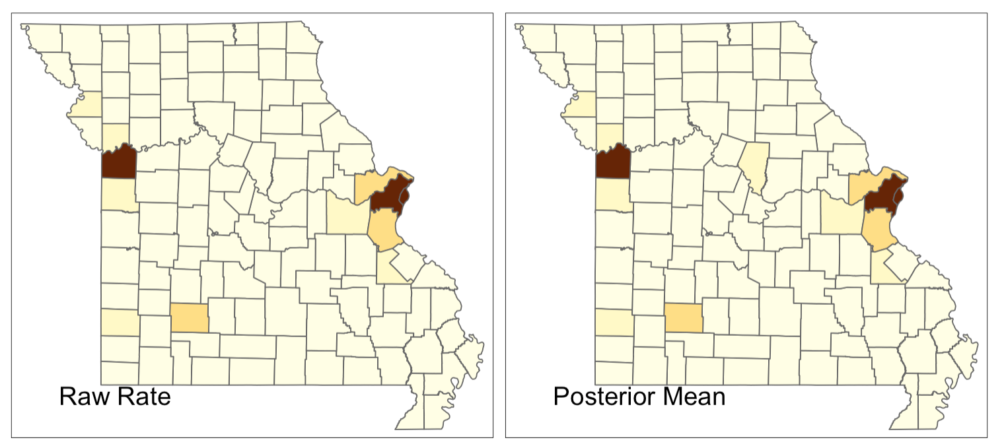
analysis
Notes:
Here is the same model for 2021. There is little different on the right bottom.
this is for 2022. the color is different in the middle.
We can see the Jackson county, St. Louis city and county are having lots of people, so they have more cases, and more vaccinations, also more deaths.

Slide 19
Things To improve
Set death rate as deaths / confirmed cases
Find other variables in county level that effect the death rate
Notes:
There are two specific things I want to improve if I have more time,
1.
The first model I create gave me an error, since I use large number to predict really small values. I think it might be different if I use deaths divide by confirmed cases as the death rate, then I can use vaccine_rate to predict death rate, when the population is the confirmed cases.
2.
I want to find other county level variables as predictor, since total_vaccine and confirmed cases are obviously factors for deaths.

Slide 20
references
Dr. Prener’s github:
https://github.com/slu-openGIS/MO_HEALTH_Covid_Tracking/tree/master/data
Population data:
https://www.missouri-demographics.com/counties_by_population
Dr. Rigdon’s BST 5600 in class code on Canvas.

